Slide 1
Poles and Zeros
The dynamic behavior of a transfer function model can be characterized by the numerical value of its poles and zeros.
Two equivalent general representation of a TF:
Chapter 6
where {z_{i}} are the “zeros” and {p_{i}} are the “poles”.
We will assume that there are no “pole-zero” cancellations. That is, that no pole has the same numerical value as a zero.
Note that, for system to be physically realizable, n>m.

Slide 2
Example: 4 poles (denominator is 4th order polynomial) & 0 zero (numerator is a const)

Slide 3
Chapter 6

Slide 4
Effects of Poles on System Response

Slide 5
Example of Integrating Element
pure integrator (ramp) for step change in q_{i}

Slide 6
Cause of Zeros – Input Dynamics

Slide 7
Some Facts about Zeros
Zeros do not affects the number and locations of the poles, unless there is an exact cancellation of a pole by a zero.
The zeros exert a profound effect on the coefficients of the response modes.

Slide 8
Example of 2nd-Order Overdamped System with One (1) Zero

Slide 9
Chapter 6

Slide 10
Step Response of 2nd-Order Overdamped System without Zeros

Slide 11
Further Analysis of Inverse Response

Slide 12
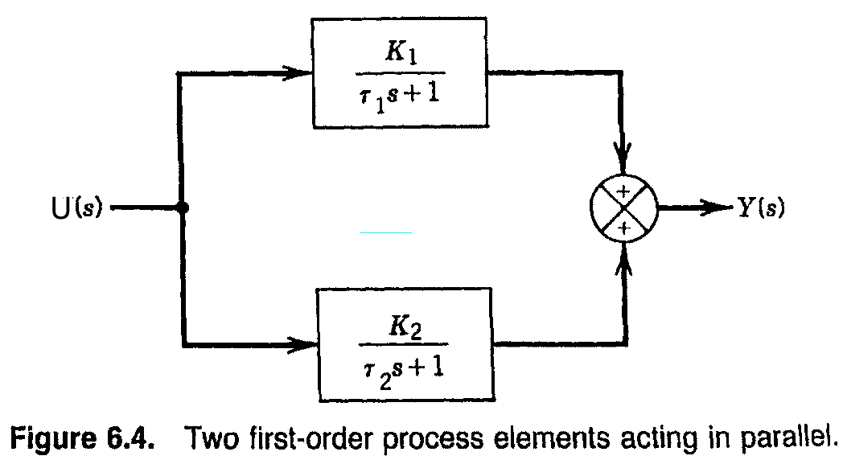
Chapter 6

Slide 13
Common Properties of Overshoot and Inverse Responses

Slide 14
Another Example

Slide 15
Time Delays
Time delays occur due to:
Fluid flow in a pipe
Transport of solid material (e.g., conveyor belt)
Chemical analysis
Sampling line delay
Time required to do the analysis (e.g., on-line gas chromatograph)
Chapter 6
Mathematical description:
A time delay, , between an input u and an output y results in the following expression:

Slide 16
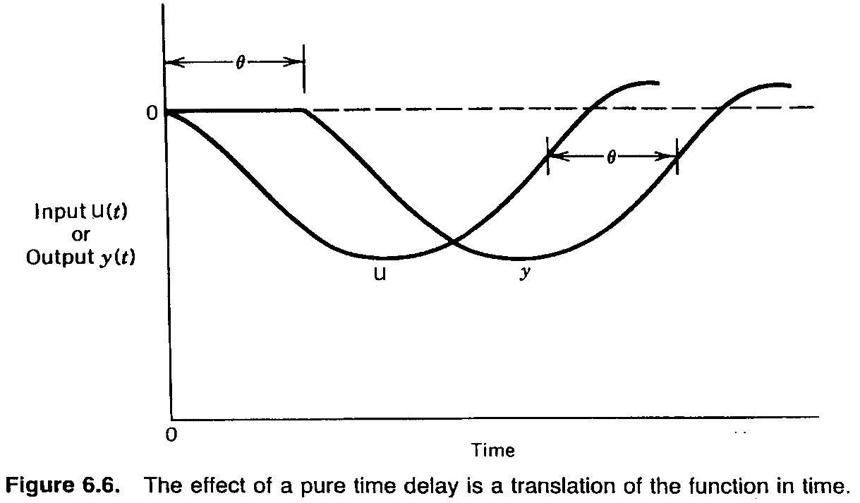
Chapter 6

Slide 17
Implication of Time Delay
The presence of time delay in a process means that we cannot factor the transfer function in terms of simple poles and zeros!

Slide 18
Polynomial Approximation of Time Delays

Slide 19
Chapter 6

Slide 20
Approximation of nth-Order Systems

Slide 21
Approximation of Higher-Order Transfer Functions
In this section, we present a general approach for approximating high-order transfer function models with lower-order models that have similar dynamic and steady-state characteristics.
Previously we showed that the transfer function for a time delay can be expressed as a Taylor series expansion. For small values of s,
Chapter 6
An alternative first-order approximation is

Slide 22
Skogestad’s “Half Rule”
Largest neglected time constant
One half of its value is added to the existing time delay (if any) .
The other half is added to the smallest retained time constant.
Time constants that are smaller than those in item 1.
Use (B)
RHP zeros.
Use (A)
Chapter 6

Slide 23
Example 6.4
Consider a transfer function:
Derive an approximate first-order-plus-time-delay (FOPDT) model,
Chapter 6
using two methods:
The Taylor series expansions (A) and (B).
Skogestad’s half rule
Compare the normalized responses of G(s) and the approximate models for a unit step input.

Slide 24
Solution
The dominant time constant (5) is retained. Applying
the approximations in (A) and (B) gives:
and
Chapter 6
Substitution into G(s) gives the Taylor series approximation,

Slide 25
(b) To use Skogestad’s method, we note that the largest neglected time constant in G(s) has a value of three.
According to “half rule” (Rule 1), half of this value is added to the next largest time constant to generate a new time constant
Rule 1: The other half provides a new time delay of 0.5(3) = 1.5.
The approximation of the RHP zero in Rule 3 provides an additional time delay of 0.1.
Approximating the smallest time constant of 0.5 in G(s) by Rule 2 produces an additional time delay of 0.5.
Thus the total time delay is,
Therefore
Chapter 6

Slide 26
Chapter 6

Slide 27
Example

Slide 28
Part (a)

Slide 29
Part (b)

